Slide 1
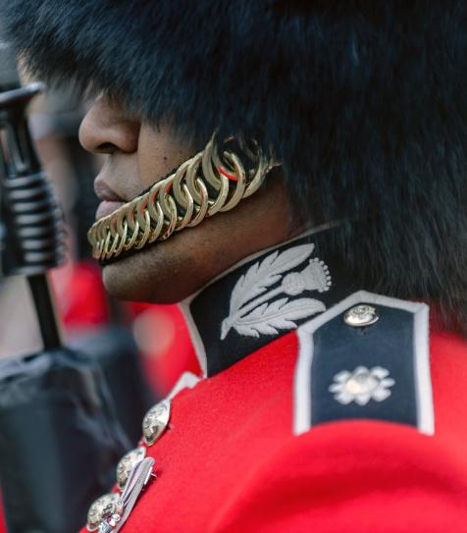

THE BRITISH ARMY:
LGBTQ+ VOICES
Assembly

Slide 2

TEACHER NOTES
  Age
    11–16 (Key Stages 3 and 4, S1–S5)
  Learning
    By the end of the lesson students will:
    understand what the term ‘LGBTQ+’ means
    identify the contributions of some LGBTQ+ people to World War One and World War Two
    explain why it is so important that the LGBTQ+ community are remembered.
  Timing
    15–20 minutes
  Guidance for creating a safe learning environment
    It is important to read through the guidance on creating a safe learning environment to follow best practice PSHE/health and wellbeing teaching. The assembly touches on sensitive topics including instances of homophobia and suicide so it is important to consider any students who may need extra support. Remember to highlight the onward signposting at the end of the assembly to ensure any vulnerable students know where they can find support and consider using an
    ask it box (or similar) where students can ask anonymous questions.
  Homophobic, biphobic and transphobic (HBT) bullying
    It is important that students are aware that no form of homophobic, biphobic or transphobic bullying is acceptable and that any comments that are made in the session that could be understood as homophobic, biphobia or transphobic will be dealt with according to school policy.
    Gatsby Benchmarks
    These resources align with the Gatsby Benchmarks for good careers provision, providing space to share information about different careers through curriculum learning.

Slide 3
CURRICULUM LINKS – ENGLAND
      PSHE
      Pupils should be taught about:
      KS3
      R5. to recognise that sexual attraction and sexuality are diverse.
      R39. the impact of stereotyping, prejudice and discrimination on individuals and relationships.
      R40. about the unacceptability of prejudice-based language and behaviour, offline and online, including sexism, homophobia, biphobia, transphobia, racism, ableism and faith-based prejudice.
      R41. the need to promote inclusion and challenge discrimination, and how to do so safely, including online.
      KS4
      R5. the legal rights, responsibilities and protections provided by the Equality Act 2010.
      R34. strategies to challenge all forms of prejudice and discrimination.
      DFE Relationships and sex education (RSE) and health education
      ‘Schools should be alive to issues such as everyday sexism, misogyny, homophobia and gender stereotypes and take positive action to build a culture where these are not tolerated, and any occurrences are identified and tackled.’
      Citizenship
      Pupils should be taught about:
      KS3
      the roles played by public institutions and voluntary groups in society, and the ways in which citizens work together to improve their communities, including opportunities to participate in school-based activities.
      KS4
      diverse national, regional, religious and ethnic identities in the United Kingdom and the need for mutual respect and understanding.
      the different ways in which a citizen can contribute to the improvement of his or her community, to include the opportunity to participate actively in community volunteering, as well as other forms of responsible activity.
      History
      Pupils should:
      KS3
      extend and deepen their chronologically secure knowledge and understanding of British, local and world history, so that it provides a well-informed context for wider learning.
      identify significant events, make connections, draw contrasts, and analyse trends within periods and over long arcs of time.
      be taught about challenges for Britain, Europe and the wider world from 1901 to the present day.
      KS4
      develop and extend their knowledge and understanding of specified key events, periods and societies in local, British, and wider world history; and of the wide diversity of human experience.
      develop the ability to ask relevant questions about the past.

Slide 4
CURRICULUM LINKS – SCOTLAND, WALES AND NORTHERN IRELAND
    Scotland
      Health and Wellbeing experiences and outcomes
      I know that friendship, caring, sharing, fairness, equality and love are important in building positive relationships. As I develop and value relationships, I care and show respect for myself and others. HWB 3-05a / HWB 4-05a.
      As I explore the rights to which I and others are entitled, I am able to exercise these rights appropriately and accept the responsibilities that go with them. I show respect for the rights of others. HWB 3-09a / HWB 4-09a.
      I recognise that each individual has a unique blend of abilities and needs. I contribute to making my school community one which values individuals equally and is a welcoming place for all. HWB 3-10a / HWB 4-10a.
      Social Studies experience and outcomes
      I can explain why a group I have identified might experience inequality and can suggest ways in which this inequality might be addressed. SOC 3-16a.
      I can use my knowledge of current social, political or economic issues to interpret evidence and present an informed view. SOC 3-15a.
      For more information see ‘LGBT Mapping Across the Curriculum for Excellence’ from LBGT Youth Scotland: lgbtyouth.org.uk/media/1585/lgbtys-curriculum-inclusion.pdf
    Wales
      PSE
      Pupils should have opportunities to:
      KS3 and KS4
      develop respect for themselves and others.
      value and celebrate diversity and equality of opportunity locally, nationally and globally be moved by injustice, exploitation and denial of human rights.
      understand how to recognise and challenge effectively expressions of prejudice, racism and stereotyping.
      History
      Pupils should have opportunities to:
      KS3 and KS4
      learn how some twentieth century individuals and events have shaped our world today.
      select, recall and organise historical information with increasing independence and accuracy.
      ask and answer the questions: what were the key changes in this period; what impact did these changes have? what significance does this period of history have for our world today?
    Northern Ireland
      Local and Global Citizenship
      Pupils should have opportunities to:
      investigate how and why conflict, including prejudice, stereotyping, sectarianism and racism may arise in
      the community.
      investigate the opportunities arising from diversity
      and multiculturalism and possible ways of promoting inclusion.
      investigate why it is important to uphold human rights standards in modern democratic societies, including meeting basic needs, protecting individuals and groups of people.
      History
      Pupils should have opportunities to:
      investigate the past and its impact on our world today.
      explore how history has affected their personal identity, culture and lifestyle.

Slide 5








WHAT CONNECTS THESE PEOPLE?
Ethel Mary Smyth
Edward Brittain
Wilfred Owen
  Suffragette, composer, British Red Cross radiographer
  Soldier awarded
  the Military Cross
  Poet and soldier
  1858–1944
  1895–1918
  1893–1918
Alan Turing
Roberta Cowell
Dudley Cave
  Mathematician, computer scientist, code breaker
  Fighter pilot
  Soldier, prisoner of war
  and activist
  1912–1954
  1918–2011
  1921–1999
    They all made significant contributions to World War One and World War Two.
5
Notes:
Introduction (5 mins)
Show students images above of six people. Give them a moment to consider what they might have in common and take a few answers from the group.
Explain that these six individuals all made contributions in WW1/WW2 and reveal the sentence underneath each.
Sources:
Edward Brittain - Bourne, Stephen (2019) Fighting Proud: The Untold Story of the Gay Men Who Served in Two World Wars
Ethel Mary Smith - www.iwm.org.uk/history/stories-of-lgbt-men-and-women-from-the-first-world-war
Wilfred Owen - Bourne, Stepehen (2019) Fighting Proud: The Untold Story of the Gay Men Who Served in Two World Wars
Dudley Cave - www.bbc.co.uk/history/ww2peopleswar/stories/36/a2688636.shtml
Alan Turing - www.bbc.co.uk/news/uk-england-manchester-48994393
Roberta Cowell - www.ucl.ac.uk/campaign/roberta-cowell

Slide 6




WHAT CONNECTS THESE PEOPLE?
    Also, they are all what would today be considered part
    of the LGBTQ+ community.
    What does LGBTQ+ stand for?
    Are you surprised at this second connection? If so, why?
    Challenge: What do you know about the progress
    pride flag?
Ethel Mary Smyth
Edward Brittain
Wilfred Owen
Alan Turing
    Progress Pride Flag! The traditional rainbow pride flag, used to represent the lesbian and gay community, was redesigned in 2018 to increase inclusion. The black and brown stripes represent people within the community who might have also been excluded because of their race and the pink/white/blue represents the transgender community.
Roberta Cowell
Dudley Cave
Notes:
Next reveal that they also happened to be what we today consider to be ‘LGBTQ+’. Invite students to answer what they understand by the term ‘LGBTQ+’ . Explain that LGBTQ stands for Lesbian, Gay, Bi, Trans and Queer* the ‘+’ is used to refer to the many other sexual and gender identities that exist outside of the heteronormative identities i.e. ‘straight’.
Stonewall defines Queer as follows: Queer is a term used by those wanting to reject specific labels of romantic orientation, sexual orientation and/or gender identity. It can also be a way of rejecting the perceived norms of the LGBT community (racism, sizeism, ableism etc). Although some LGBT people view the word as a slur, it was reclaimed in the late 80s by the queer community who have embraced it.
Ask students if they are surprised at this second connection? If so, why?
(e.g. most people weren’t open about being LGBTQ+ then, due to social attitudes and the law, so the LGBTQ+ community were less visible.)
Explain that in this assembly/form time, you are going to explore the negative impact of discrimination and the positive benefits of inclusion.
Challenge: Invite students to share anything they might know about the Progress Pride Flag. Then click to reveal the information about the Progress Pride Flag.

Slide 7
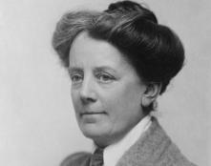
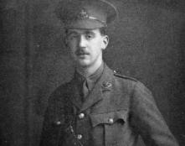



LGBTQ+ VOICES
    LGBTQ+ people were there and contributing in WWI/II and in all periods of history, although many had to keep this part of their identity secret.
Ethel Mary Smyth
Edward Brittain
    A composer and a suffragette.
    Served with the British Red Cross
    in WWI.
    Made a Dame for her services
    to music.
    WWI soldier awarded the Military Cross
    in 1916.
    Warned by his commander to ‘be more cautious’ about his relationships.
    Reported to have died in action in 1918.
Notes:
Strength in diversity (6-8 mins)
Explain to the assembly/form that all these people in all their difference had potential to contribute – courage, science, poetry etc. It was their diverse attributes and skills that allowed them to make their contributions to the war and the world, big and small. Show students the fact-files on each individual over the next three slides and ask them to reflect on what each individual contributed throughout history, what skills they had and what challenges they may have faced.
Further information
Ethel Smyth
Ethel was a composer and a suffragette, before the war she campaigned for women’s right to vote and wrote the anthem of the suffragette movement.
During the First World War she served with the British Red Cross in Italy and France, and trained as a radiographer, volunteering at a huge French hospital.
She returned to the UK after the war and was made a Dame for her services to music. She had several passionate affairs during her life, mostly with women. She described her sexuality as an ‘everlasting puzzle’ and was romantically linked to many women, and a few men over the course of her life, including Emmeline Pankhurst, Edith Craig (theatre director and suffragette), Virginia Woolf and Henry Brewster (to whom she confided that it was ‘easier for me to love my own sex passionately, rather than yours’).
Edward Brittain
Edward was awarded the Military Cross in 1916 for his leadership and bravery on the first day of the Battle of the Somme.
He had relationships with a number of different soldiers, but was warned by his commander to ‘be more cautious’ as homosexuality wasn’t allowed in the Army at that time.
He is thought to have died in action in 1918, although some historians have speculated that is was death by suicide.
Sources:
Ethel Mary Smith - iwm.org.uk/history/stories-of-lgbt-men-and-women-from-the-first-world-war
Edward Brittain - Bourne, Stepehen (2019:36) Fighting Proud: The Untold Story of the Gay Men Who Served in Two World Wars
Images:
Ethel Mary Smith - en.wikipedia.org/wiki/File:Ethel_Smyth.jpg
Edward Brittain - © IWM HU 86397 iwm.org.uk/collections/item/object/205020757

Slide 8
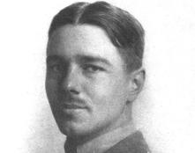
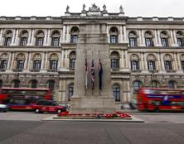


LGBTQ+ VOICES
Wilfred Owen
Dudley Cave
    Military Cross winner killed just before WWI’s end.
    One of Britain’s most famous war poets.
    Had a romance with fellow poet Siegfried Sassoon: ‘I was always a mad comet but you have fixed me’.
    WWII soldier and Japanese Prisoner of War (POW).
    Described how drag artists ‘helped lift the men’s spirits’ in WWII.
    Post war he was angered by the reinforced ban on gay service people in the Forces.
Notes:
Further information
Wilfred Owen
Wilfred Owen fought in the First World war, earning the Military Cross for bravery. He was killed just one week before the war ended.
He has become one of Britain’s most famous war poets, for his rich, raw and brutal descriptions of the experience of war. His best known poems include ‘Anthem for Doomed Youth’, ‘Futility’, ‘Dulce Et Decorum Est’, ‘The Parable of the Old Men and the Young’ and ‘Strange Meeting’.
He had a romantic relationship with fellow poet Siegfried Sassoon and wrote in one of his letters to Sassoon, ‘I love you….so very much….you have fixed my life, I was always a mad comet but you have fixed me’.
Dudley Cave
Dudley risked his life during WW2, and nearly died in a Japanese Prisoner of War camp.
He was forced to resign from his job in a cinema after the war because of societal attitudes towards gay men.
Before his death, he reflected on the importance of drag performers during the war who were mostly gay men and were ‘regarded with considerable affection, their camp humour helped lift the men's spirits’. Dudley related how during WWII being gay was accepted. Indeed, when he was discharged after the war, he was advised by an Army doctor ‘to find someone of like mind to settle down with, and not to worry about being gay’.
This added to his anger about the reinforcement of the ban on gay service people after the end of the war, feeling the contribution of gay soldiers in WWII had been forgotten and disrespected. In 1998, in one of his last public actions before his death, he laid a pink triangle wreath at a Ceremony of Remembrance at the Cenotaph. The pink triangle was used by the Nazi party to mark gay men sent to concentration camps, in the 70s it was revived as a symbol of protest against homophobia. Cave died just before the lifting of the military ban.
Sources:
Wilfred Owen - Bourne, Stepehen (2019:172) Fighting Proud: The Untold Story of the Gay Men Who Served in Two World Wars
Dudley Cave - www.bbc.co.uk/history/ww2peopleswar/stories/36/a2688636.shtml

Slide 9
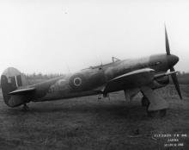
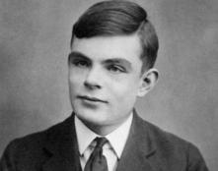

LGBTQ+ VOICES
Roberta Cowell
Alan Turing
    A competitive racing driver.
    Pilot and German POW during WWII.
    Transitioned from male to female in 1950. She was happy with the result, but was forced to
    stop racing.
    Built a codebreaking machine which helped
    end WWII.
    Prosecuted for his relationship with another man.
    He died by suicide in 1954.
        Received a government apology in 2009 and a royal pardon in 2013.
Notes:
Further information
Roberta Cowell
Roberta Elizabeth Marshall Cowell was a competitive racing driver who competed in the Antwerp Grand Prix in 1939.
She went on to become a pilot in the RAF, fighting during World War Two and flying spitfires and Hawker Typhoon (pictured) aircraft, at one stage being captured by German Troops and held for five months.
In 1950, Roberta met a British surgeon called Michael Dillon, who supported her to transition from male to female. She was pleased with the result, but had to stop racing due to the discrimination she faced.
Alan Turing
Alan Turing was one of the most influential scientists and mathematicians in the UK in the last century.
He worked for the government during World War Two at Bletchley Park where he created a codebreaking machine which helped bring an end to the war.
In 1952 he was found guilty at trial for having a relationship with another man. He died by suicide in 1954. In 2009 he received an official apology from the government and was given a royal pardon in 2013.
Sources:
Roberta Cowell - www.ucl.ac.uk/campaign/roberta-cowell
Alan Turing - https://www.bbc.co.uk/news/uk-england-manchester-48994393 and Bourne, Stepehen (2019:172) Fighting Proud: The Untold Story of the Gay Men Who Served in Two World Wars
Images:
Roberta Cowell - AIRCRAFT OF THE ROYAL AIR FORCE 1939-1945: HAWKER TYPHOON © IWM ATP 13583C https://www.iwm.org.uk/collections/item/object/205126644 an image of Roberta herself can be viewed: https://en.wikipedia.org/wiki/File:Roberta_cowell.png

Slide 10
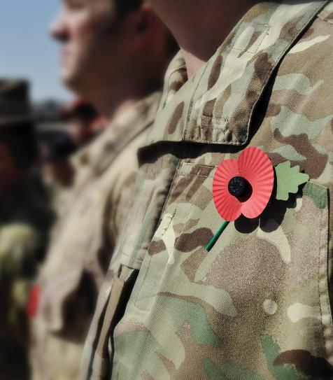

LGBTQ+ IN THE PAST
    One important challenge that all six of these people faced was that they weren’t able to be themselves.
    Laws and social attitudes meant it was hard for them to be open about being LGBTQ+.
    Homosexuality was against the law and trans rights were not recognised.
    Gay, lesbian and bisexual people weren’t allowed to join the Army until 2000, though many did.
  Reflection:
    What is the impact of having to hide who you are?
    Why is it important to remember these people and tell their full
    stories now?
Notes:
The Historical Context (1-2 mins)
Read through the information on the slide and invite students to reflect for a moment on the impact of having to hide who you are and the importance of remembering the full histories of these people.
*Trans people were not explicitly banned from the Army before 2000, but were excluded in practise as their rights were not recognised.

Slide 11



LGBTQ+ TODAY
    Learning more about LGBTQ+ issues.
    Social attitudes have changed and there are many laws that protect LGBTQ+ rights and protect people from discrimination.
    There is still more that can be done to ensure everyone feels comfortable being themselves and can make the most of their unique qualities and talents. One thing we can all do is be an ally to LGBTQ+ people.
    Being an ally means supporting LGBTQ+ people, even if you don’t identify as LGBTQ+. Some of the ways to be an ally are:
    Challenging and reporting any form
    of bullying towards LGBTQ+ people.
    Making sure LGBTQ+ people feel safe and supported.
    Connecting with LGBTQ+ people and celebrating the strength in diversity.
Notes:
LGBTQ+ today (1 min)
Read through the information on the slide to highlight that huge amounts of progress have been made in society, but sadly discrimination towards LGBTQ+ people still exists and that there are ways we can support LGBTQ+ friends, family members and people in wider society.

Slide 12
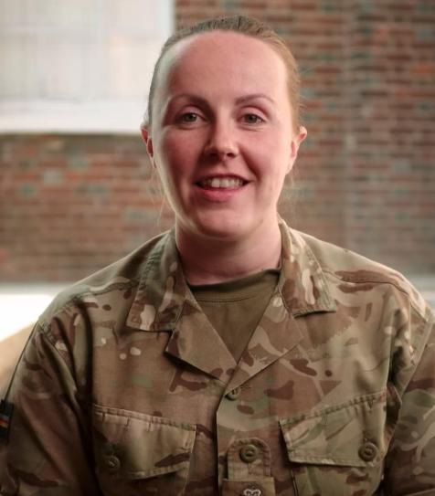


THE ARMY – EVERYONE IS WELCOME
    The Army has a large LGBTQ+ network and actively celebrates and encourages diversity and the strength it brings.
    Watch the video with current LGBTQ+ Army members
    to find out more about their experiences today.
    Find out more at: armylgbt.org.uk
Notes:
The Army – Everyone is welcome (3 mins)
Show students the clip about how the Army actively celebrates and encourages diversity. Ask them to reflect on why inclusion and diversity are so important to the Army.

Slide 13
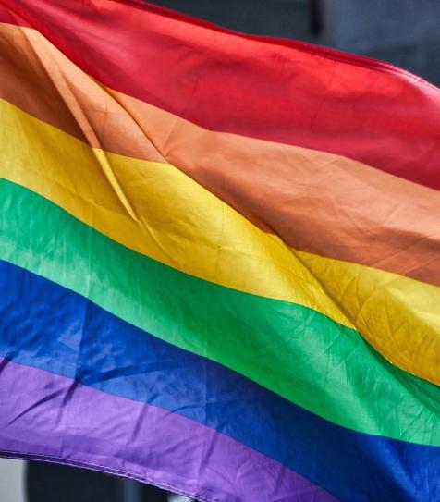

OUR SCHOOL COMMUNITY – EVERYONE IS WELCOME
  Reflection:
    What one thing can you do to be an ally to
    the LGBTQ+ Community?
    Challenging and reporting any form
    of bullying towards LGBTQ+ people.
    Connecting with LGBTQ+ people and celebrating
    the strength in diversity, e.g. supporting Pride,
    learning about LGBT history.
    Learning more about LGBT issues, e.g. read/listen to podcasts.
    Making sure LGBTQ+ people feel safe and supported,
    e.g. looking out for LGBTQ+ classmates, checking in
    with LGBTQ+ friends to see how they are.
    Sources of Support:
    School Pastoral System
    Trusted Adult
    Stonewall
    GIDS Gender Identity
    Development Service
    Childline/NSPCC
    The Proud Trust
Notes:
Final Reflection and Signposting (1 min)
Remind students that every individual is celebrated and valued. Ask them to reflect on one thing they could do to be an ally in their school community.
Remind students that if anyone if questioning their gender or sexuality and feels like they want support, that they should speak to a trusted adult, a member of the pastoral team or seek support from one of the following organisations:
Stonewall
GIDs
Childline/NSPCC
The Proud Trust
For further LGBTQ+ support and training in Northern Ireland see: cara-friend.org.uk/

Slide 14
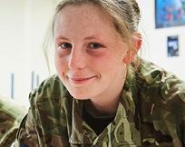
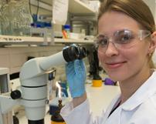
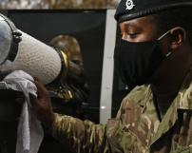

FIND OUT MORE ABOUT BRITISH ARMY CAREERS
Army Foundation
College Harrogate
Army Officer Scholarship Scheme
Army Apprenticeships
    Discover a college experience like no other for 16 and 17 year olds starting their career in the British Army. More
    Receive sponsorship through sixth form and university, before joining the Army in a leadership role. More
    Explore the 40+ apprenticeship schemes in the British Army, from animal care to vehicle maintenance. More
Notes:
Additional information
Find out more about British Army careers and share with students as appropriate.

