Slide 1

Year 6 SATs
Presentation for Parents, Carers & Guardians

Slide 2
What are the SATs?
SATs are the Standardised Assessment Tests that are given to children at the end of Key Stage 2.
The SATs take place over five days in May. The SATs papers consist of:
  Grammar, punctuation and spelling (paper 1: GPS)
  Grammar, punctuation and spelling (paper 2: Spelling)
  Reading
  Maths (paper 1: Arithmetic)
  Maths (paper 2: Reasoning)
  Maths (paper 3: Reasoning)
  Writing is assessed using evidence collected throughout Year 6. There is no Year 6 SATs writing test.
The key stage 2 tests will be taken on set dates unless your child is absent, in which case they may be able to take them up to 5 school days afterwards.
Notes:
Note that this government guidance (https://www.gov.uk/government/news/changes-to-key-stage-2-assessment-dates-in-2023) outlines changes in dates for 2023. This includes guidance on KS2 timetable variations if schools have pre-planned activities on Friday 12th May.

Slide 3
When and how the SATs are completed
The tests take place during normal school hours, under exam conditions.
Children are not allowed to talk to each other from the moment the assessments are handed out until they are collected at the end of the test.
After the tests are completed, the papers are sent away to be marked externally.
The results are then sent to the school in July.
Each test lasts no longer than 60 minutes:
  Spelling, punctuation and grammar (paper 1: Grammar/ Punctuation) – 45 minutes
  Spelling, punctuation and grammar (paper 2: Spelling) – 15 minutes
  Reading – 60 minutes
  Maths (paper 1: Arithmetic) – 30 minutes
  Maths (paper 2: Reasoning) – 40 minutes
  Maths (paper 3: Reasoning) – 40 minutes

Slide 4
Specific arrangements for SATs
Children with additional needs (who have similar support as part of day-to-day learning in school) may be allocated specific arrangements, including:
Additional (extra) time;
Tests being opened early to be modified;
An adult to scribe (write) for them;
Using word processors independently;
An adult to read for them (including a translator);
The use of prompts or rest breaks;
Arrangements for children who are ill or injured at the time of the tests.
Pupils with an EHCP are automatically allowed up to 25% additional time (except for the spelling paper, which is not strictly timed). Pupils who use the modified large print or braille versions of the tests are automatically allowed up to 100% additional time.
Notes:
The DfE Key Stage 2 access arrangements guidance (https://assets.publishing.service.gov.uk/government/uploads/system/uploads/attachment_data/file/1109963/2023_key_stage_2_access_arrangements_guidance.pdf) gives more details on this, including which arrangements need prior permission.
It should be noted that there are cases when pupils can have access to multiple arrangements (e.g. addition time and a scribe). These are detailed in the above document.
Also note, any pupil can ask for a question to be read to them, though not explained to them. In mathematics, words and numbers may be read but mathematical symbols cannot be read.

Slide 5
The results
Tests are marked externally. Once marked, the tests will be given the following scores:
A raw score (total number of marks achieved for each paper);
A scaled score (see below);
A judgement on if the National Standard has been met.
After marking each test, the external marker will convert the raw score to a scaled score. Even though the tests are made to the same standard each year, the questions must be different. This means the difficulty of the tests may vary. Scaled scores ensures an accurate comparison of performance over time.
Scaled scores range from 80 to 120.
A scaled score of 100 or more shows the pupil is meeting the National Standard.
Notes:
This year, the test results will be available on the PAG on Tuesday 4th July (https://assets.publishing.service.gov.uk/government/uploads/system/uploads/attachment_data/file/1110107/2023_key_stage_2_assessment_and_reporting_arrangements.pdf section 9.1)
There is no separate test that would indicate a pupil is working above the national standard.
A scaled score of less than 99 would indicate a pupil is working below the national standard.
To have a scaled score, pupils must have a minimum raw score (determined each year). If the pupil does not achieve the minimum raw score, they have not demonstrated sufficient understanding of the KS2 curriculum in the subject.

Slide 6
Grammar, Punctuation and Spelling
Grammar, punctuation and spelling consists of two papers.
Paper 1 focuses on all three elements (grammar, punctuation and spelling or GPS). The paper lasts for 45 minutes.
Paper 2 consists of a spelling test only. It should take approximately 15 minutes, although this is not a set amount of time (pupils should be given as much time as they need to complete the test).

Slide 7
Grammar, Punctuation and Spelling: Paper 1 (GPS)
The children will have been working hard with their class teacher on developing and securing their knowledge of the technical vocabulary needed in this test.
This test focuses on:
Grammatical terms/ word classes;
Functions of sentences;
Combining words, phrases and clauses;
Verb forms, tenses and consistency;
Punctuation;
Vocabulary;
Standard English and formality.
This test requires a range of answer types but does not require longer formal answers.
Notes:
The question types include:
Circling
Drawing lines to connect
Multiple choice questions (including ticking tables)
One-word answers
Short answer questions

Slide 8
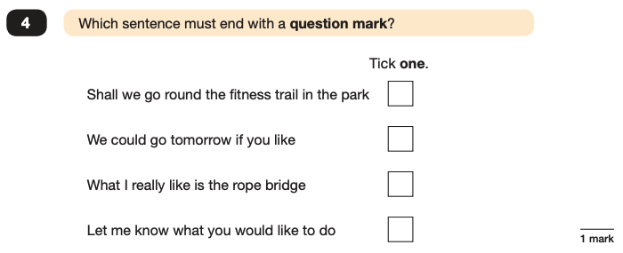
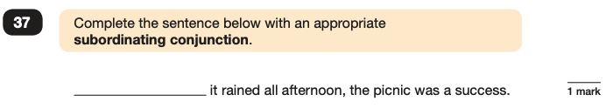
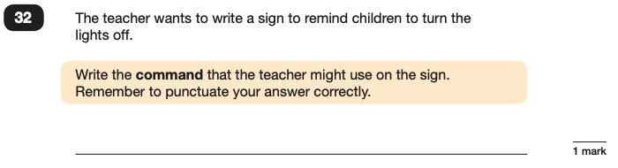
Grammar, Punctuation and Spelling: Paper 1 (GPS)
Example questions:
✓
e.g. Although, While
e.g. Switch off the lights! Please turn off the lights
Notes:
For questions 32 and 37, there are various correct answers.

Slide 9
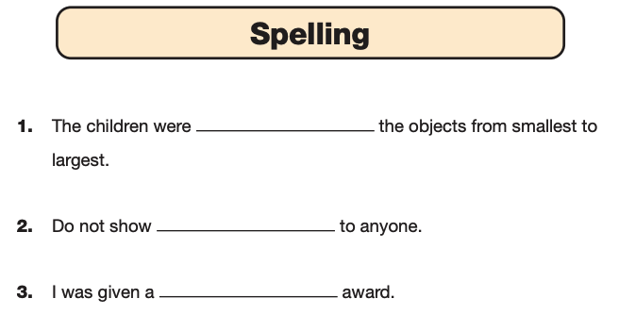
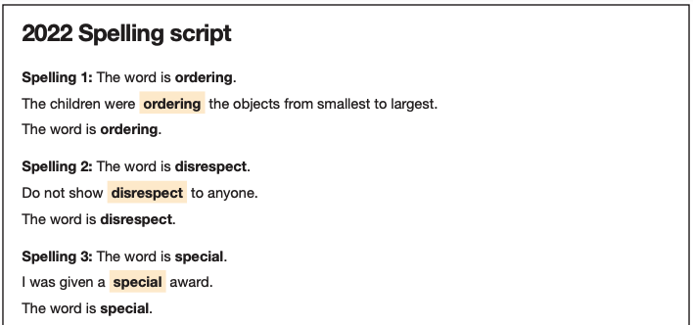
Grammar, Punctuation and Spelling: Paper 2 (spelling)
Paper 2 is a shorter paper that focuses solely on spellings.
Example questions:
Notes:
There is a spelling script that accompanies this. Example:
The word is creature. The dragon is an imaginary creature. The word is creature.

Slide 10
Reading
There is one reading test that lasts for 60 minutes.
The test is designed to measure if the children’s comprehension of age-appropriate reading material meets the national standard. There are three different set texts for children to read. These could be any combination of non-fiction, fiction and/ or poetry.
The test covers the following areas :
Give/ explain the meaning of words in context;
Retrieve and record information/ identify key details from fiction and non-fiction;
Summarise main ideas from more than one paragraph;
Make inferences from the text/ explain and justify inferences with evidence from the text;
Predict what might happen from details stated and implied;
Identify/ explain how information/ narrative content is related and contributes to meaning as a whole;
Identify/ explain how meaning is enhanced through choice of words and phrases;
Make comparisons within the text.

Slide 11
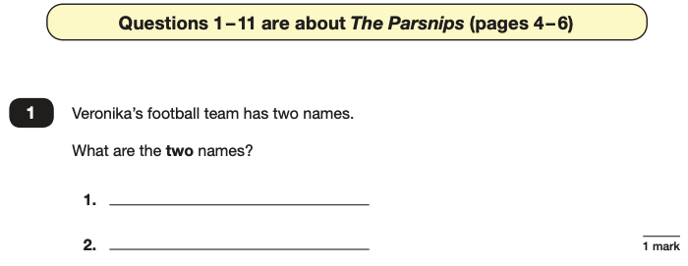
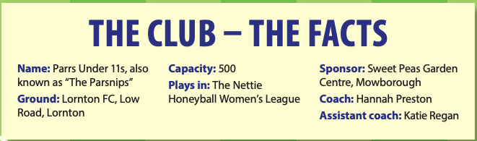
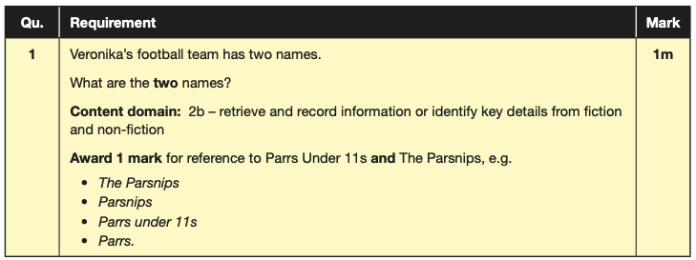
Reading
The reading SATs paper requires a range of answer styles.
Example questions:
Notes:
Question styles include:
Multiple choice questions
One-word answers
Short answer questions
Multiple mark (long answer) questions

Slide 12
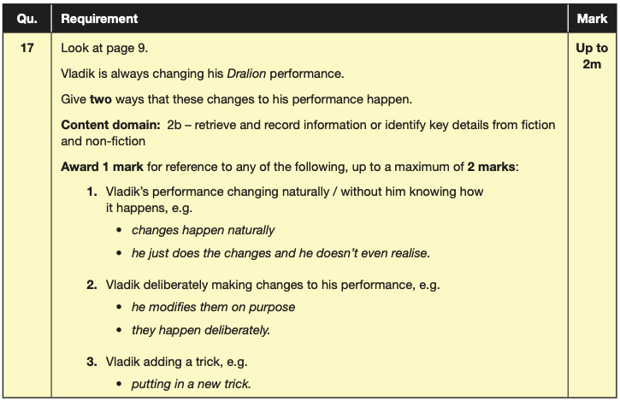
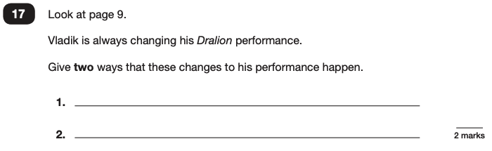
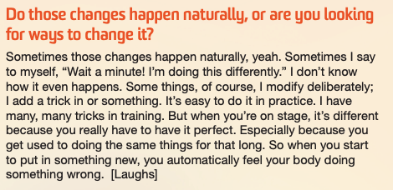
Reading
Example questions:
Based on text 2: My Circus Life

Slide 13
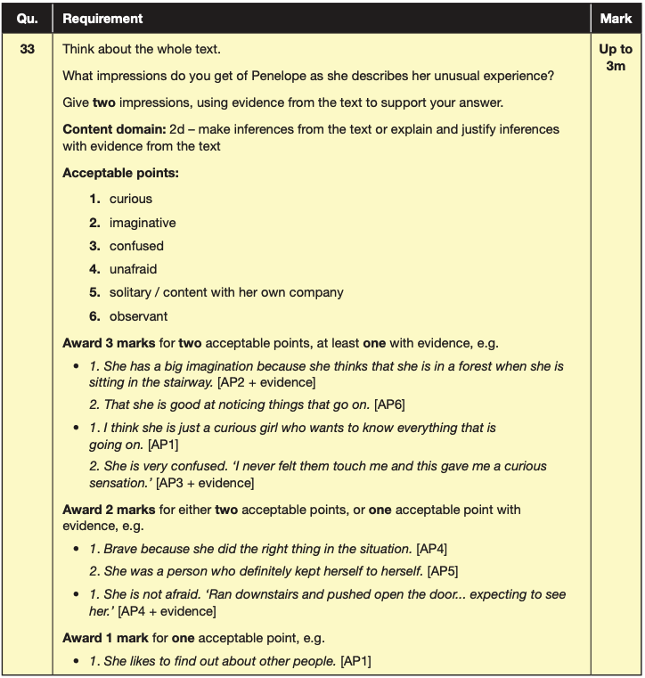
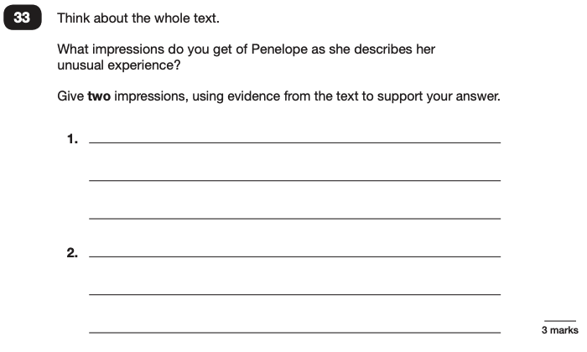
Reading
Example questions:
Based on the whole text

Slide 14
Reading
Since the current testing formation for the SATs began in 2016, there has been a tendency for three types of questions to be the most popular.
In the 2022 Reading SATs paper,
10% of marks could be gained from answering questions involving giving and explaining the meaning of words in context;
38% of marks could be gained from answering questions involving retrieving and recording information or identifying key details from a text;
44% of marks could be gained from answering questions involving making inferences from a text and justifying inferences with text evidence.
When reading with your child at home try focusing on these types of questions.
Notes:
Example questions to ask at home:
What does this word mean?
Which word in this paragraph is the closest in meaning to…?
What [character] doing when [event] happened?
True or false questions about a paragraph/ text.
Why do you [character] did [event]? Can you think of another reason?

Slide 15
Maths
The maths assessments consist of three tests.
Paper 1: Arithmetic (30 minutes)
Paper 2: Reasoning (40 minutes)
Paper 3: Reasoning (40 minutes)

Slide 16
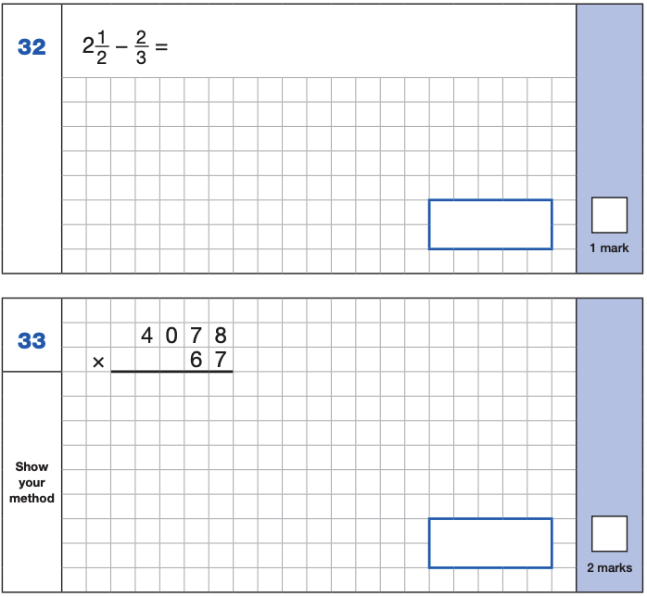
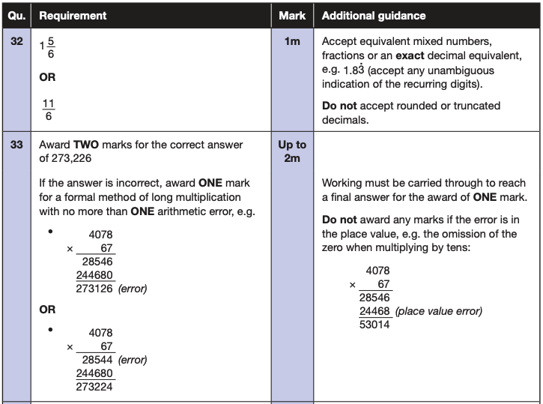
Maths Paper 1 (Arithmetic)
The maths arithmetic paper has a total of 40 marks and lasts for 30 minutes.
The test covers the four operations (addition, subtraction, multiplication, division, including order of operations requiring BIDMAS), percentages of amounts and calculating with decimals and fractions.
Example questions:
Notes:
Identify that there are some questions that have 2 marks and some that have 1.

Slide 17
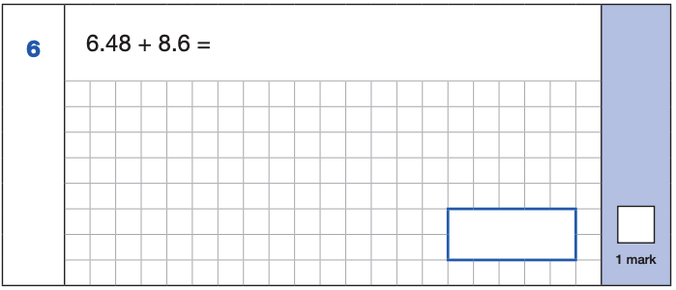
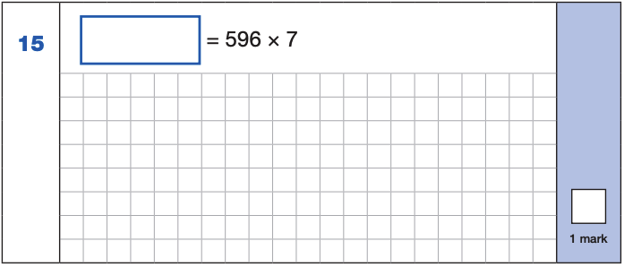
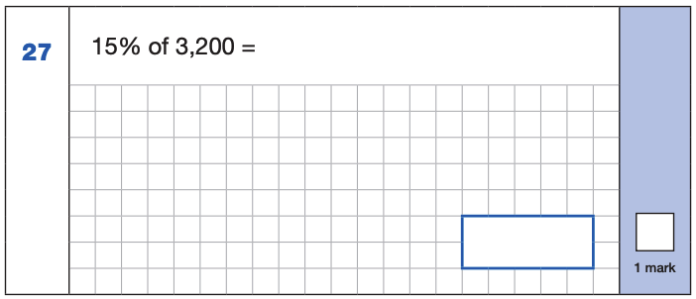
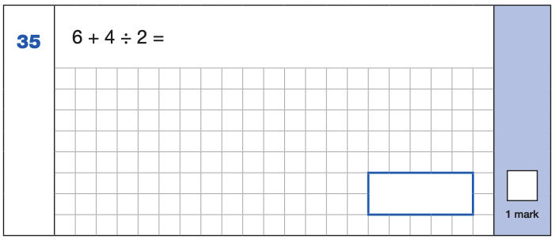
Maths Paper 1 (Arithmetic)
Example 1 mark questions:
4,172
6.48
+ 8.6 .
15.08
¹
596
x 7
4172
⁶ ⁴
15.08
10% of 3,200 = 320
5% of 3,200 = 160
15% of 3,200 = 480
4 ÷ 2 = 2
6 + 2 = 8
480
8
Notes:
These are examples of how children could solve the calculations. There are some that could/ should be solved mentally as it is far quicker that way (40 marks in 30 minutes does not allow for 1 minute + per mark).
Answers should always be given in their simplest form unless stated otherwise.

Slide 18
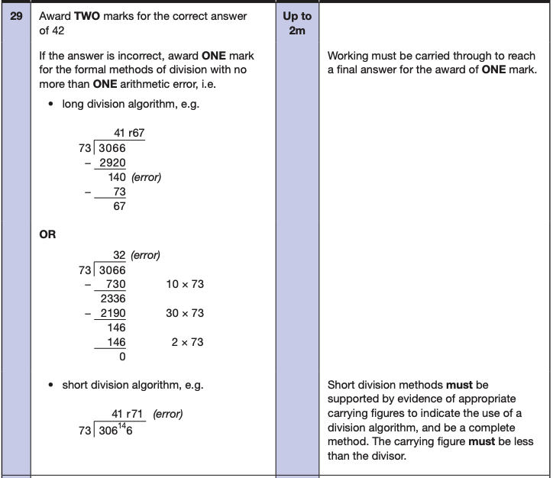
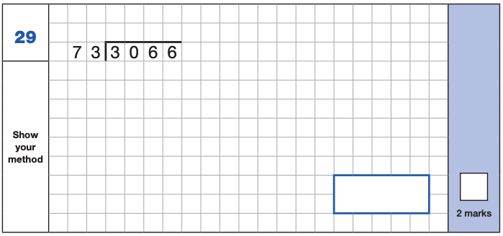
Maths Paper 1 (Arithmetic)
Example 2 mark question:

Slide 19
Maths Papers 2 and 3 (Reasoning)
Paper 2 and paper 3 tests have a total of 35 marks each and lasts for 40 minutes each.
These papers require children to demonstrate their mathematical knowledge and skills, as well as their ability to solve problems and their mathematical reasoning. They cover a wide range of mathematical topics from key stage 2 including,
Number and place value (including Roman numerals);
The four operations;
Geometry (properties of shape, position and direction);
Statistics;
Measurement (length, perimeter, mass, volume, time, money);
Algebra;
Ratio and proportion;
Fractions, decimals and percentages.
Notes:
In general, the questions get progressively harder throughout the paper. As this is the case, it is not unusual for children to be unable to complete the entire paper in the given time.

Slide 20
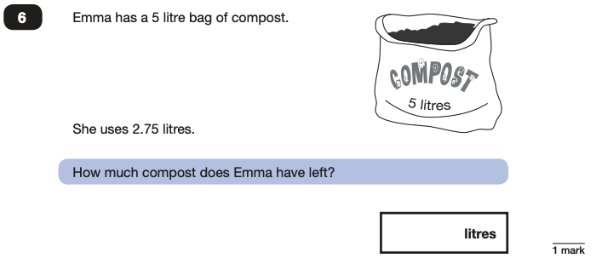
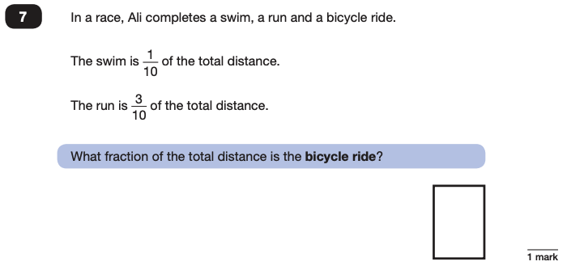

Maths Papers 2 (Reasoning)
Example questions:
2.25
$$\frac{\text{6}}{\text{10}}$$

Slide 21
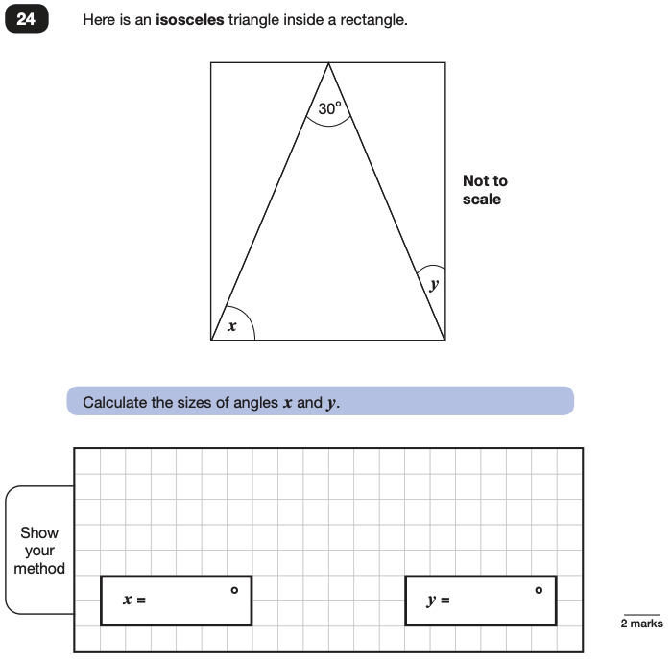
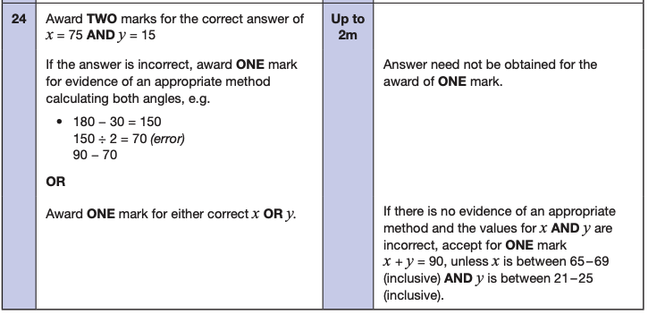
Maths Papers 2 (Reasoning)
Example question:

Slide 22
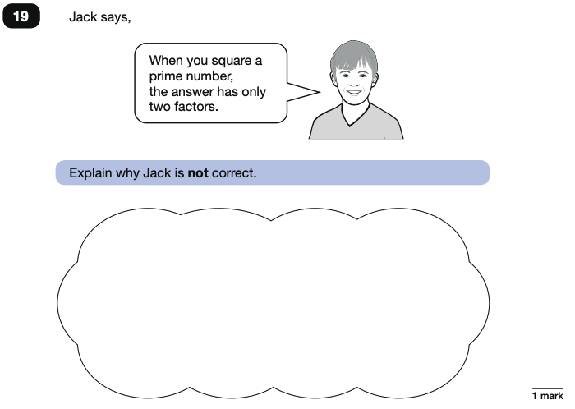
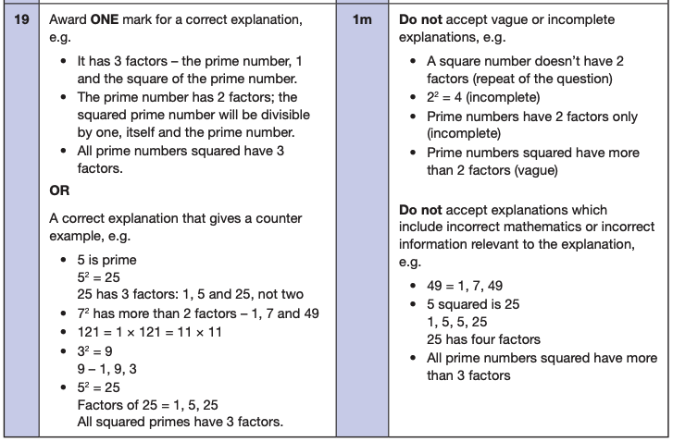
Maths Papers 3 (Reasoning)
Example questions:

Slide 23
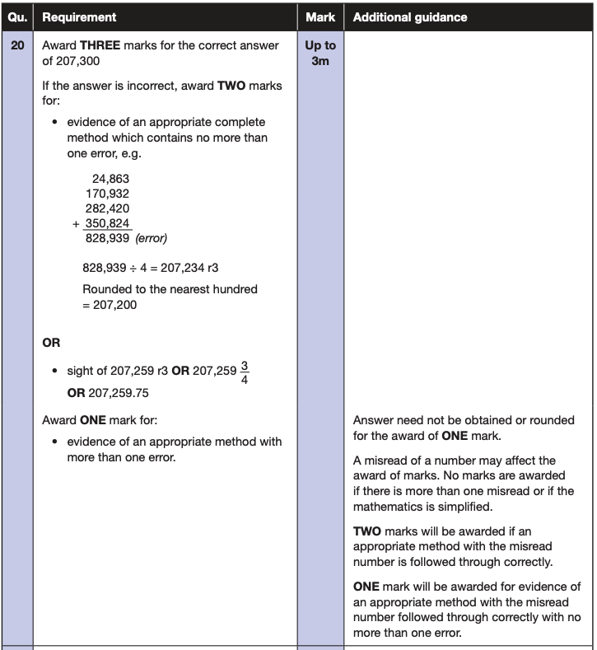
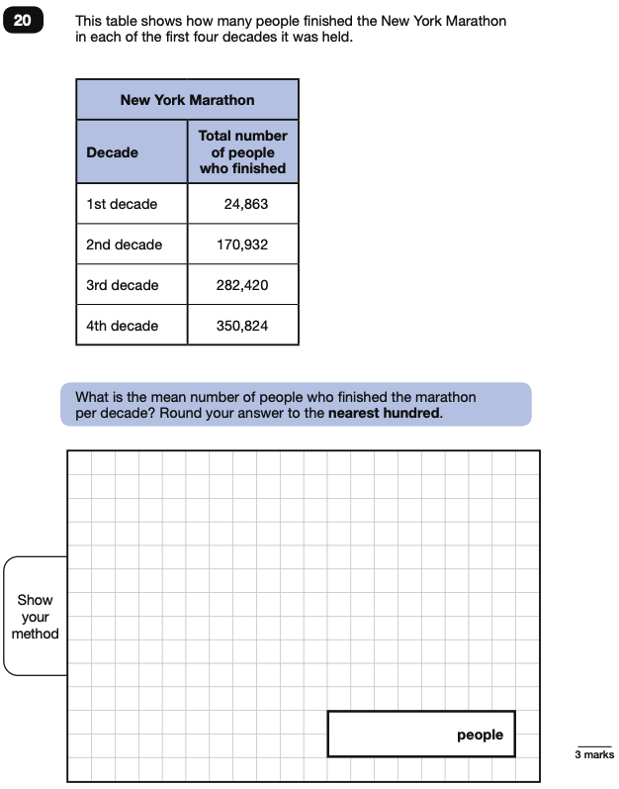
Maths Papers 3 (Reasoning)
Example question:
Notes:
Note that this is a three mark question.

Slide 24
Supporting your child in preparing for the SATs
Firstly, a positive attitude goes a long way. Give them as much encouragement and support as you can (but we don’t need to tell you that)!
Tips:
Don’t use past papers as they are used in school to prepare the children.
Talk to your child’s class teacher if you have any concerns rather than worry your child.
Encourage your child to talk to their teacher or a trusted adult (including yourself) about their worries.
Give your child a quiet, distraction free space to complete homework or study.
Give your child time to go outside and reduce screen time.
Ensure your child is eating and drinking well and getting a good amount of sleep.
Plan something nice and fun for the weekends before and after SATs. This will help them to relax before the SATs and give them something to look forward to after.
Notes:
Encourage parents not to use past papers at home. If they want to use past papers with tutors, suggest that they could take copies of completed test home to work through with tutors. This may help them to work through specific misunderstandings.

Slide 25
Supporting your child in preparing for the SATs
Further tips:
Create a revision timetable that works for you and your child. For some families, 10 to 20 minute activities over a few days works best. For others, a longer study session one day a week might be better.
Keep revision light. Going over key skills (times tables, real world mental maths as you are shopping or cooking) is a good way to keep revision light.
As we said before, avoid using past papers. There are plenty of free or inexpensive SATs practice materials for parents available.
If you’re looking to support your child further with maths at home, there are lots of good websites with free Year 6 revision resources. Start with thirdspacelearning.com/blog/category/for-parents/ or register free for the Third Space Learning Maths Hub (mathshub.thirdspacelearning.com)

Slide 26
Things to remember about SATs
SATs focus on what children know about Maths and English.
They will not reflect how talented they are at science, geography, art, PE…, and they certainly won’t highlight all of their amazing personal characteristics.
SATs don’t tell the whole story.
Their results will say if they did or did not meet a certain standard but not necessarily by what margin. These thresholds change each year according to the overall national performance, so what was classed as ‘meeting the expected standard’ this year might not be the same as last year. Your school may be able to provide you with more detailed feedback.
SATs are only four days out of a whole Primary School career.
In reality, there’s one or two papers each day that last 30 to 60 minutes.

Slide 27
Advice for Year 6 children
Listen to your teacher.
The adults you work with all want you to do your best.
Get plenty of sleep and eat well, this will help your brain.
Read all the questions carefully. This can help you to avoid silly mistakes.
Don’t panic. There may be questions you think you can’t answer. Take a deep breath. Read it again. You can always move on and go back to it later. It’s often better to write something rather than nothing.
Remember that the Year 6 SATs last for 4 days out of your whole life!
“Stay focused in class so you don’t have loads of extra studying to do at home!” – Year 7 pupil’s advice.

Slide 28
Preparation for SATS
Please make sure that child has good attendance- don’t miss school
Please, please, please support your children during the year with their homework
Children are expected to know 12x12 times tables- please keep practising them at home
Daily reading at least 10 min aloud
Monitor Bedrock progress
Practise spellings daily

Slide 29
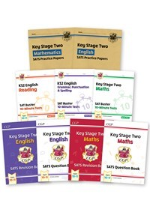
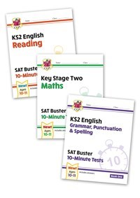
Retail Price: £40.00
School Price: £20.00
Retail Price: £14.00
School Price: £6.50

